Slide 1
Introducing MAFs: Music Acoustic Features and their Relationship to Personality
Maya B. Flannery¹ and Matthew H. Woolhouse²
¹Department of Psychology, Neuroscience & Behaviour, McMaster University
²School of the Arts, McMaster University
contact: flannerm@mcmaster.ca
BACKGROUND
METHODS
RESULTS I
RESULTS II
DISCUSSION
Background
Music-genre preferences are linked to personality, though classification inconsistencies limit this research^{1,2}
Previous studies reveal relationships between primary and secondary genres based on acoustic features³; e.g. “Metal-heads” prefer faster tempo Jazz
Research question
Is there a relationship between personality and preference for acoustic features (e.g., tempo, mode, register) in western music?

Slide 2
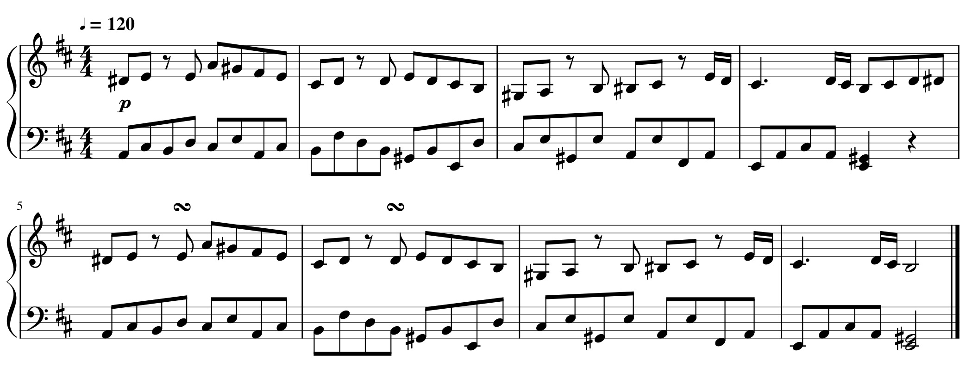
Introducing MAFs: Music Acoustic Features and their Relationship to Personality
Maya B. Flannery¹ and Matthew H. Woolhouse²
¹Department of Psychology, Neuroscience & Behaviour, McMaster University
²School of the Arts, McMaster University
contact: flannerm@mcmaster.ca
BACKGROUND
METHODS
RESULTS I
RESULTS II
DISCUSSION
Participants
Undergraduate students (N = 90, 76 female)
Ages ranged from 17–21 (M = 18.5, SD = 0.68)
Musical training ranged from no training (n = 26) to more than 10 years (n = 15) [M = 4.1]
Stimuli (Within-Subjects IV)
Dynamic: Forte/Piano
Stimulus intensity was normalized
Spectral and amplitude envelopes differed; produce ‘soft’ versus ‘hard’ playing
Mode: Major/Minor
Original work in Major key
Transposed to parallel minor
Piece: Three 16-second piano excerpts from
Bach, Prelude in C# Major, BWV 848
Mozart, Piano Sonata in D Major, K311
Beethoven, Sonata in A Major, No. 2, Op. 2
Register: High/Low
Transposition carried out with respect to original register
One octave higher; one octave lower
Tempo: Fast/Slow;
Adjusted for each piece to equal 16 seconds in duration
Factor combinations resulted in 48 stimuli
Personality Measure (Between-Subjects IV)
Big Five Inventory: 44-item questionnaire determining an individual’s position along five personality factors:
Extraversion, Agreeableness, Conscientiousness, Neuroticism, Openness
Stimulus example
Example of Mozart stimulus with piano dynamic, major mode, low register, and fast tempo
Analysis
Personality factors were arranged into “High” and “Low” levels (above or below the median for that factor)
Separate mixed factorial ANOVAs were performed for each personality factor
Personality factors were between-subject variables
Music acoustic features were within-subject factors
Participants were treated as random-effects
Preference (Dependent Variable)
Rate preference from “Dislike” (0) to “Like” (100) for each stimulus

Slide 3
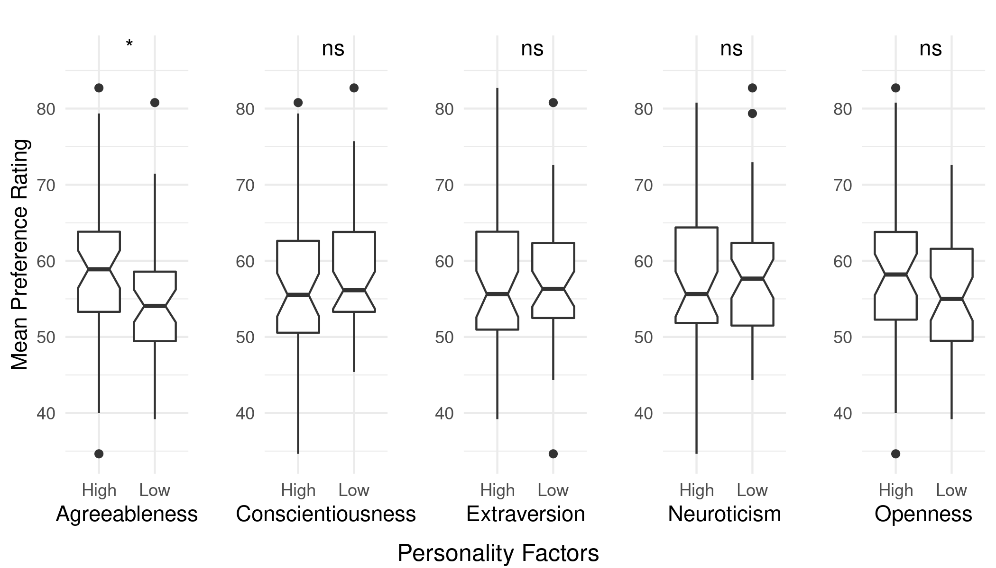
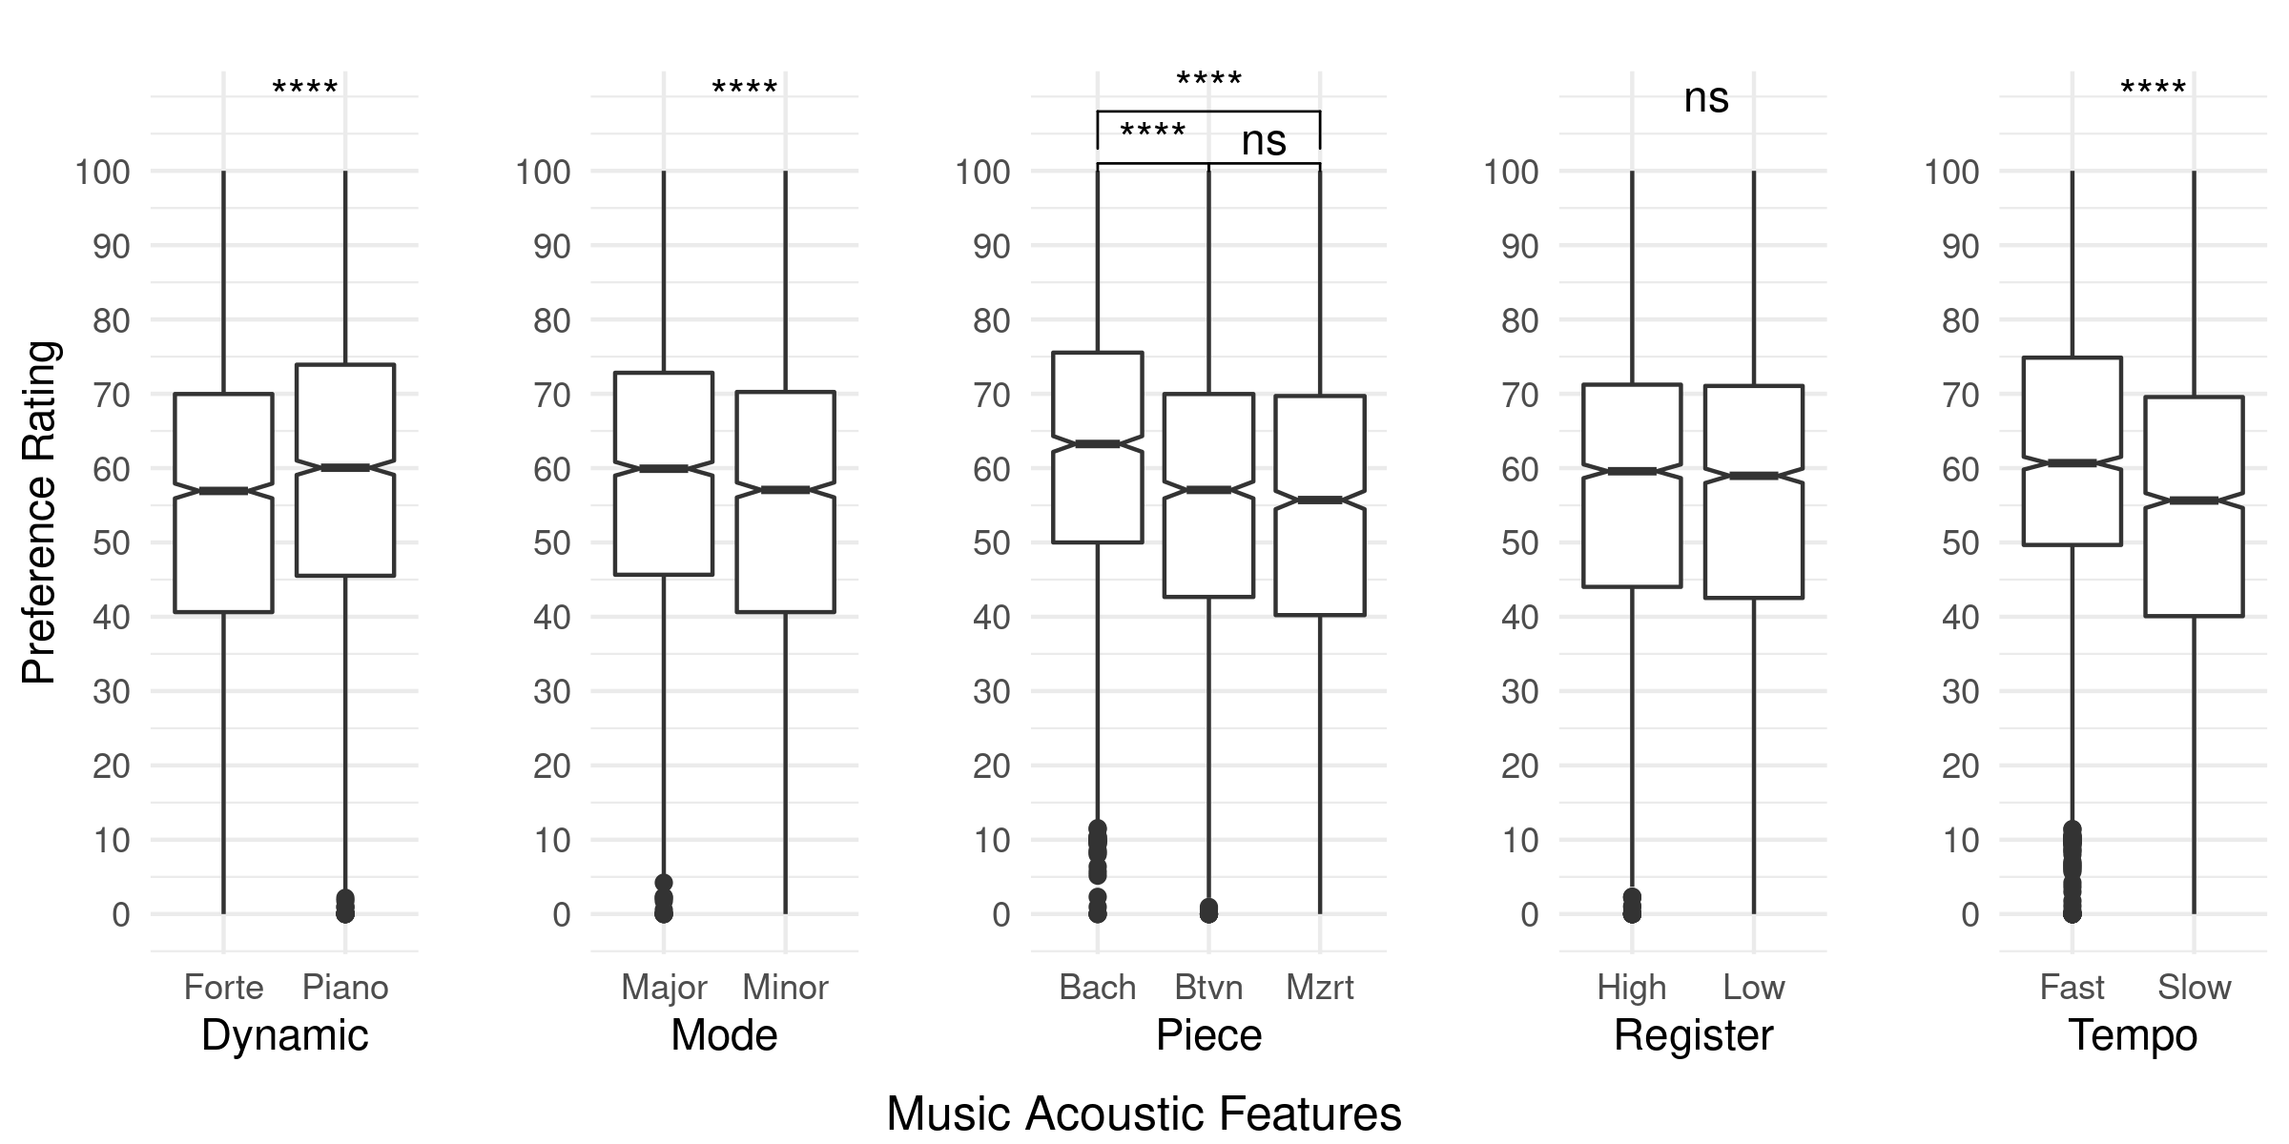
Introducing MAFs: Music Acoustic Features and their Relationship to Personality
Maya B. Flannery¹ and Matthew H. Woolhouse²
¹Department of Psychology, Neuroscience & Behaviour, McMaster University
²School of the Arts, McMaster University
contact: flannerm@mcmaster.ca
BACKGROUND
METHODS
RESULTS I
RESULTS II
DISCUSSION
Main Effects: MAFs
There were significant main effects for four of the five MAFs on preference ratings:
Dynamic, F(1, 4218) = 50.001, p < .001, η²_{p} = .012: piano was preferred over forte
Mode, F(1, 4218) = 34.238, p < .001, η²_{p} = .008: major was preferred over minor
Piece, F(2, 4218) = 61.488, p < .001, η²_{p} = .028: Bach was preferred over both Beethoven and Mozart
Tempo, F(1, 4218) = 110.156, p < .001, η²_{p} = .025: fast was preferred over slow
Register did not have a significant main effect
Main Effects: Personality Factors
Agreeableness, F(1, 88) = 5.13, p < .026, η²_{p} = .001: participants with high levels of Agreeableness rated stimuli higher overall

Slide 4
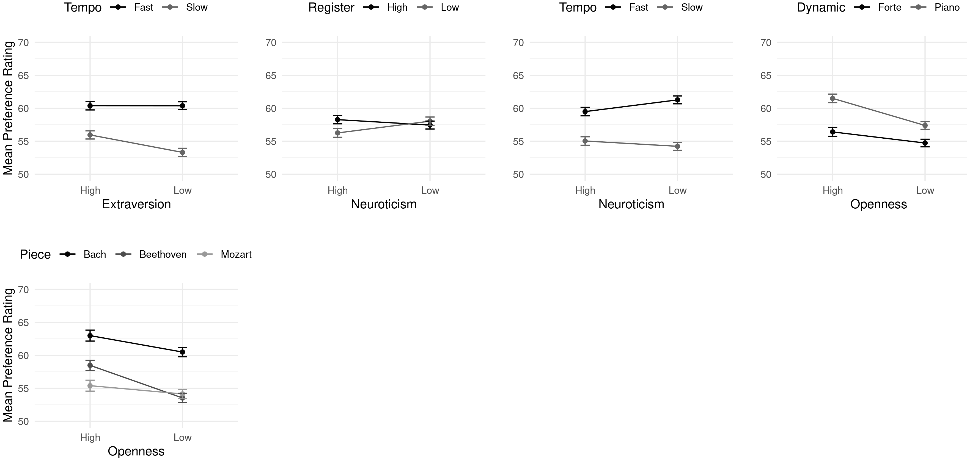
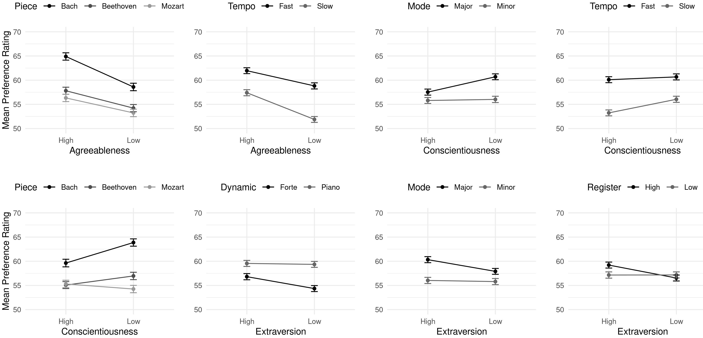
Introducing MAFs: Music Acoustic Features and their Relationship to Personality
Maya B. Flannery¹ and Matthew H. Woolhouse²
¹Department of Psychology, Neuroscience & Behaviour, McMaster University
²School of the Arts, McMaster University
contact: flannerm@mcmaster.ca
BACKGROUND
METHODS
RESULTS I
RESULTS II
DISCUSSION
Interactions: Personality and MAFs
Each personality factor interacted with at least two MAFs
Agreeableness with Piece and Tempo
Conscientiousness with Mode, Piece, and Tempo
Extraversion with Dynamic, Mode, Register, and Tempo
Neuroticism with Tempo and Register
Openness with Dynamic and Piece

Slide 5
Introducing MAFs: Music Acoustic Features and their Relationship to Personality
Maya B. Flannery¹ and Matthew H. Woolhouse²
¹Department of Psychology, Neuroscience & Behaviour, McMaster University
²School of the Arts, McMaster University
contact: flannerm@mcmaster.ca
BACKGROUND
METHODS
RESULTS I
RESULTS II
DISCUSSION
Discussion
Results of this study support the link between personality and music preference.
Participants high in Agreeableness had higher preferences for music independent of MAFs. This result is in agreement with Bansal et al. (2020)⁴, which found listeners with high levels of Agreeableness were genre-inclusive—they had a wide range of musical taste.
There were clear preferences for Bach excerpts over Beethoven and Mozart; future studies should investigate a larger variety of musical features, such as melody, harmony, and timbre, which may explain this variation.
Piano dynamic, major mode, and fast tempo had higher preference ratings independent of personality factors. These features, especially major mode and fast tempo, are common in popular music. Future studies should investigate these relationship in more detail.
Interactions between personality factors and MAFs can be linked to genre, music-preferences dimensions, and psychological attributes of music. For example, high extraversion is related to preference for major-mode, and in Greenberg et al. (2016)³, it is related to high arousal music—major-mode music and arousal may be linked as well—a topic for future research.
References
1. Aucouturier, J.-J., & Pachet, F. (2003). Representing Musical Genre: A State of the Art. Journal of New Music Research, 32(1), 83–93.
2. Greenberg, D. M., Kosinski, M., Stillwell, D. J., Monteiro, B. L., Levitin, D. J., & Rentfrow, P. J. (2016). The Song Is You: Preferences for Musical Attribute Dimensions Reflect Personality. Social Psychological and Personality Science, 7(6), 597–605.
3. Barone, M. D., Bansal, J., & Woolhouse, M. H. (2017). Acoustic Features Influence Musical Choices Across Multiple Genres. Frontiers in Psychology, 8, 931.
4. Bansal, J., Flannery, M. B., & Woolhouse, M. H. (2020). Influence of personality on music-genre exclusivity. Psychology of Music.
Ethics
Approved by McMaster Research and Ethics Board: #2524.
Funding
SSHRC Insight Development Grant (#430 2012 0835) and McMaster Arts Research Board.
Acknowledgments
Thank you Joanna Spyra, Wendy Tang, Madeline Komer for your support.

